Slide 1
Connectionist Computing
COMP 30230/41390
Gianluca Pollastri
office: CASL, ground floor Science East.
email: gianluca.pollastri@ucd.ie
Connectionist Computing COMP 30230

Slide 2



Credits
Geoffrey Hinton, University of Toronto.
  borrowed some of his slides for “Neural Networks” and “Computation in Neural Networks” courses.
Ronan Reilly, NUI Maynooth.
  slides from his CS4018.
Paolo Frasconi, University of Florence.
  slides from tutorial on Machine Learning for structured domains.
Connectionist Computing COMP 30230

Slide 3
Lecture notes on Moodle
https://csmoodle.ucd.ie/moodle/course/view.php?id=288
Strictly confidential...
Enrolment key: 30230cc
Connectionist Computing COMP 30230

Slide 4
Books
No book covers large fractions of this course.
Parts of chapters 4, 6, (7), 13 of Tom Mitchell’s “Machine Learning”
Parts of chapter V of Mackay’s “Information Theory, Inference, and Learning Algorithms”, available online at:
http://www.inference.phy.cam.ac.uk/mackay/itprnn/book.html
Chapter 20 of Russell and Norvig’s “Artificial Intelligence: A Modern Approach”, also available at:
http://aima.cs.berkeley.edu/newchap20.pdf
More materials later..
Connectionist Computing COMP 30230

Slide 5
Marking
3 landmark papers to read, and submit a 10-line summary on Moodle about: each worth 6.67%
a small connectionist tool to build and play with: 30%
Final exam: 50%
Connectionist Computing COMP 30230

Slide 6
Assignment 1
Read the first section of the following article by Marvin Minsky:
http://web.media.mit.edu/~minsky/papers/SymbolicVs.Connectionist.html
down to “.. we need more research on how to combine both types of ideas.”
Submit through Moodle a 250 word MAX summary by February 14th at 23:59, any time zone of your choice (Baker Island?).
One third of a grade down every day late, that is: if you deserve an A and you’re 1 day late you get an A-, 2 days late a B+, etc.
Make sure it's gone through!
Connectionist Computing COMP 30230

Slide 7
Restricted Boltzmann Machines (RBM)
We restrict the connectivity to make inference and learning easier.
  Only one layer of hidden units.
  No connections between hidden units.
It only takes one step to reach equilibrium when the visible units are clamped..
j
hidden
visible
i
Connectionist Computing COMP 30230

Slide 8
So far
Perceptrons: multiple input directly connected to one output. Typical output function: binary-threshold
Associators: multiple inputs directly connected to multiple outputs, linear output function.
Hopfield nets/Boltzmann machines: feedback networks, binary-threshold (or sigmoid) output/probabilistic in BM. May have hidden units.
Connectionist Computing COMP 30230

Slide 9
Learning
We will need concepts of learning theory.
What is learning exactly, after all?
Connectionist Computing COMP 30230

Slide 10
Types of learning task
Supervised learning:
  learning to predict output when examples of input and corresponding output are available.
Reinforcement learning:
  no real supervision, only occasional payoff: e.g. I don’t know if a chess move is correct but I know if I win.
Unsupervised learning:
  I want to create an internal representation of the data, e.g. in form of clusters, extract relevant features for further tasks, etc.
Connectionist Computing COMP 30230

Slide 11
Supervised learning
A set of examples: <x,f(x)>
  x is some object (instance) ∈ X (instance space)
  f(⋅) is an unknown function
Learning algorithm will guess h(⋅) ≈ f(⋅)
Inductive learning hypothesis
  Any h(⋅) that approximates f(⋅) well on training examples will also approximate f(⋅) well on new (unseen) instances x. This isn’t necessarily true, of course..
Connectionist Computing COMP 30230

Slide 12
Types of supervised learning task
f(x) is a real value/an array of real values: regression
f(x) is a discrete value; f(x)∈{y₁ ..y_{K}}: classification
  if K=2, binary classification
Connectionist Computing COMP 30230

Slide 13
Example
Medical diagnosis (classification)
  x: set of properties for a patient (symptoms, lab tests, previous diseases)
  f(x): disease
  <x,f(x)>: Database of past medical records
  Type of x: a fixed-length array (attribute/value representation), maybe with missing attributes
  Type of f(x): a discrete value or a fixed-width array
Connectionist Computing COMP 30230

Slide 14
Example
Making a computer read (classification?)
  x: letters of sentences in some language
  f(x): corresponding sound features (in context)
  <x,f(x)>: Database of texts/corresponding sound features extracted from humans reading.
  Type of x: a fixed-length array
  Type of f(x): a fixed-length array
Connectionist Computing COMP 30230

Slide 15
Supervised learning
Training examples: <x,f(x)>
Hypothesis space: set H of functions that (hopefully) contains the target function f(⋅)
Result of learning: a function h(⋅)∈H approximating f(⋅)
Examples are used to guide the algorithm to choose a good h(⋅)∈H
Connectionist Computing COMP 30230

Slide 16
Supervised learning
h(⋅) is called a consistent hypothesis if it agrees with f(⋅) on all training examples
  After observing the data, only some hypotheses in H are consistent. They form the so called version space :
  {h(⋅)∈H : h(x)=f(x) ∀ example x}
A consistent learner always outputs a consistent hypothesis (i.e., it is 100% accurate on the training set)
The empirical error is the fraction of training examples such that h(x)≠f(x) (0% in a consistent learner)
Connectionist Computing COMP 30230

Slide 17
Example (boolean functions)
Four boolean variables as input features:
x=(x₁,x₂,x₃,x₄)∈{0,1}⁴
f(x₁,x₂,x₃,x₄) = ¬x₂ ∧ x₄ (but it is unknown)
x₁
Unknown
function
x₂
y=f(x₁,x₂,x₃,x₄)
x₃
x₄
x₁ | x₂ | x₃ | x₄ | y
0 | 0 | 1 | 1 | 1
1 | 0 | 0 | 1 | 1
1 | 0 | 1 | 1 | 1
1 | 1 | 0 | 0 | 0
1 | 1 | 1 | 0 | 0
Training
examples
Connectionist Computing COMP 30230

Slide 18
Hypothesis space 1
x₁ | x₂ | x₃ | x₄ | Y
0 | 0 | 0 | 0 | ?
0 | 0 | 0 | 1 | ?
0 | 0 | 1 | 0 | ?
0 | 0 | 1 | 1 | ?
0 | 1 | 0 | 0 | ?
0 | 1 | 0 | 1 | ?
0 | 1 | 1 | 0 | ?
0 | 1 | 1 | 1 | ?
1 | 0 | 0 | 0 | ?
1 | 0 | 0 | 1 | ?
1 | 0 | 1 | 0 | ?
1 | 0 | 1 | 1 | ?
1 | 1 | 0 | 0 | ?
1 | 1 | 0 | 1 | ?
1 | 1 | 1 | 0 | ?
1 | 1 | 1 | 1 | ?
No knowledge: H is the set of all boolean functions on 4 variables. |H|=2¹⁶≈64×10³
Connectionist Computing COMP 30230

Slide 19
Hypothesis space 1
x₁ | x₂ | x₃ | x₄ | Y
0 | 0 | 0 | 0 | ?
0 | 0 | 0 | 1 | ?
0 | 0 | 1 | 0 | ?
0 | 0 | 1 | 1 | 1
0 | 1 | 0 | 0 | ?
0 | 1 | 0 | 1 | ?
0 | 1 | 1 | 0 | ?
0 | 1 | 1 | 1 | ?
1 | 0 | 0 | 0 | ?
1 | 0 | 0 | 1 | 1
1 | 0 | 1 | 0 | ?
1 | 0 | 1 | 1 | 1
1 | 1 | 0 | 0 | 0
1 | 1 | 0 | 1 | ?
1 | 1 | 1 | 0 | 0
1 | 1 | 1 | 1 | ?
After observing 5 examples we are left with
2¹⁶⁻⁵=2¹¹=2048 consistent hypotheses
A randomly-picked consistent h(⋅) is unlikely to approximate f(⋅) well…
What is wrong?
Connectionist Computing COMP 30230

Slide 20
Hypothesis space 2
A literal is a variable x_{i} or its negation ¬x_{i}
A term is the conjunction of literals
H= {terms over x₁,x₂,x₃,x₄}
|H|=3⁴=81 (each variable is affirmed, is negated, isn’t present)
Learning algorithm:
  Initial h(⋅) = conjunction of all possible literals
  Remove literals associated with inconsistent positive examples
Connectionist Computing COMP 30230

Slide 21
Learning conjunctions
1. h = ¬x₁x₁¬x₂x₂¬x₃x₃¬x₄x₄
2. Observe 1st training example, remove
literals x₁, x₂,¬x₃, and ¬x₄
h = ¬x₁¬x₂ x₃ x₄
x₁ | x₂ | x₃ | x₄ | y
0 | 0 | 1 | 1 | 1
1 | 0 | 0 | 1 | 1
1 | 0 | 1 | 1 | 1
3. Observe 2nd training example, remove
literals ¬x₁ and x₃
h = ¬x₂ x₄
4. Observe 3rd training example:
nothing to do (h = ¬x₂ x₄)
5. No more positive training examples
Output h = ¬x₂ x₄
Connectionist Computing COMP 30230

Slide 22
Learning as refinement
Start with a small hypothesis class (e.g., boolean conjunctions)
  this means we need to know a priori something about the solution
Use examples to infer the particular function (e.g. conjunction) in the class.
Connectionist Computing COMP 30230

Slide 23
Generalisation
So far we discussed how well we learn the training set.
What really matters is how well we generalise i.e. how well we perform on instances not seen before.
Connectionist Computing COMP 30230

Slide 24
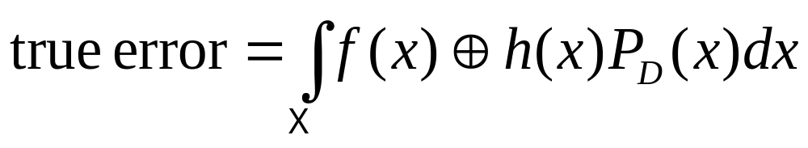
Generalisation
f(⋅)
Negative
examples
h(⋅)
Positive
examples
Connectionist Computing COMP 30230

Slide 25
Generalisation
Are there boundaries on generalisation error?
How expressive is a model, i.e. once we know how to learn:
  what can we learn?
  how many examples do we need to learn?
For instance: how complex a task can we learn with N neurons / how many examples do we need to train them?
Connectionist Computing COMP 30230

Slide 26
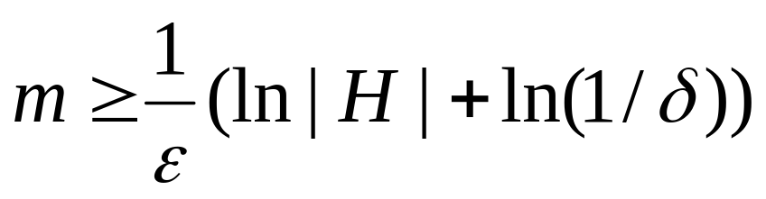
PAC learning
Probably Approximately Correct (hopefully)
H finite, unknown data distribution D, consistent learner
Then we need at least
training examples to guarantee that the true error will be < ε with probability > (1-δ)
m is called sample complexity
Connectionist Computing COMP 30230

Slide 27
Example
1000 functions in H, δ=1%, ε=1%
m ≥ 100 (ln 1000 + ln 100) = 1151.3
Connectionist Computing COMP 30230

Slide 28
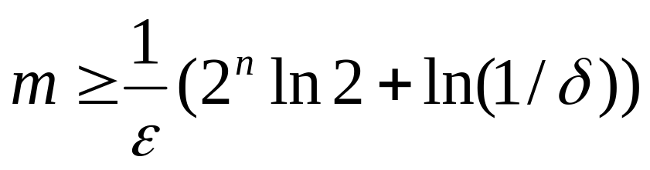
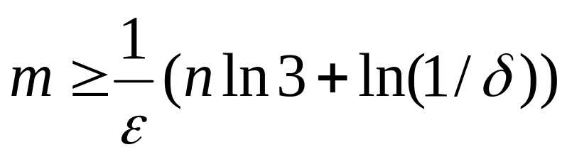
Examples
Hypothesis space 1: |H|=2^{2n}
Intractable!!
  Hypothesis space 2: |H|=3^{n}
Polynomial
Connectionist Computing COMP 30230

Slide 29
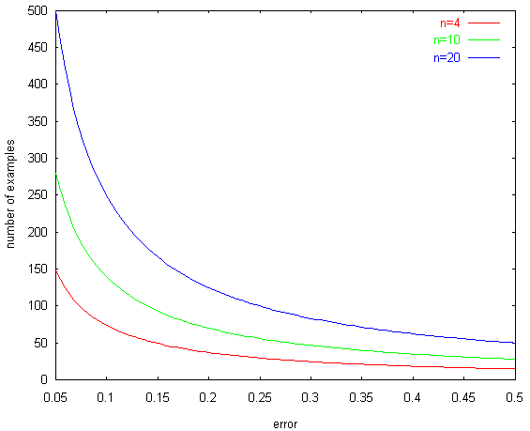
Sample complexity bound
δ=0.05
Connectionist Computing COMP 30230

Slide 30
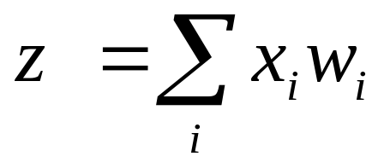
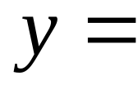
Binary threshold neuron
1
1 if z>θ
y
0 otherwise
0
z
threshold
How powerful is it, how many examples do we need? Can we apply PAC boundaries?
Connectionist Computing COMP 30230

